Slide 1


21491 Great Mills Road, Suite 100
Lexington Park, MD 20653-1220
(301) 737-1911
www.n-s-i.us
INTRO BRIEF
5 March 2009
Notes:
POC: DATA OWNER
Slide Type: TEXT

Slide 2
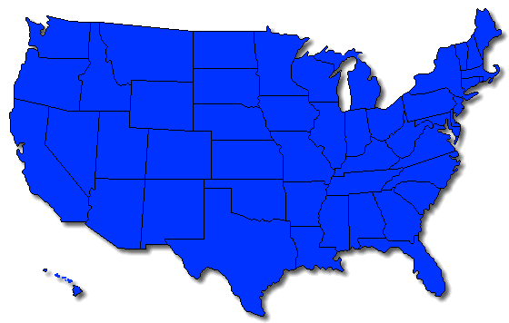

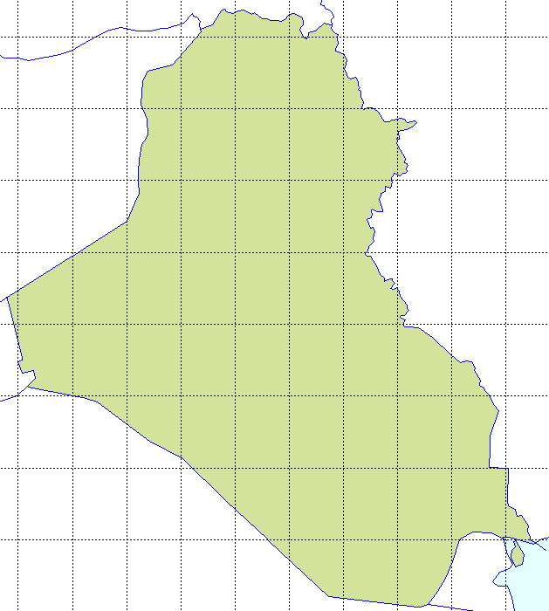
Global U.S. National Security Services Provider
Pax
HQ
NSI
Cherry
Point
China
Lake
Cohesive team of professionals with Global Reach
Exceptional depth of operational and technical knowledge and experience
Driven toward meaningful results – tangible benefits to Warfighter!
Jax
Iraq

Slide 3
Additional NSI Data Points
Size/Type: Veteran Owned Small Business (VOSB) with ~55 employees and FY09 sales of ~$8-9 million
Primary Market: PEO/PMA Support
  Three SeaPort-e Prime TOs – PMAs 234 (EA-6B), 231 (E-2/C-2), 274 (Pres Helos)
  Subcontractor Support – U&W/263 (Common Systems, USA), 276 (H-1), 202 (Aircrew Systems), 272 (TACAIR Protection), FRC SE, NAWCAD/WD
Industry Partners
  Large Businesses: L-3, CSC, Tybrin, Booz Allen, Wyle, Serco, Tecolote, J. F. Taylor, AAI
  Small Businesses: AS&T, Compliance
Mission: To create and deliver products and services of unmatched value that answer our clients’ most pressing needs
QUALITY
★
INTEGRITY
★
VICTORY!

Slide 4

Presence
H-1 Program (PMA 276)
Presidential Helicopters Program (PMA 274)
EA-6B Program (PMA 234)
E-2/C-2 Program (PMA 231)
Unmanned Air Systems (UAS) Program (PEO U&W)
Aircrew Systems (PMA-202)
Tactical Aircraft Protection Systems (PMA 272)
Comptroller (AIR 10.0/AD 10.0)
FRC Southeast (Jacksonville, FL)
NUSIA and JCIED at NAWCWD (China Lake, CA)
Logistics Civil Augmentation Program (LOGCAP) (Iraq)

Slide 5
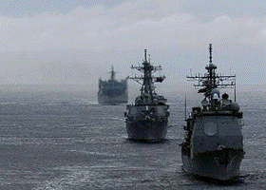

Corporate Leadership
Ed Rule
  Navy Supply Corps Officer, Acqn Professional, DAWIA L3 in Business, Cost Est. and FM
  BBA, MBA
  BFM for PMA-234 (EA-6B), PEO(T), & ASN(RDA)
  Prior industry experience as Management / Sr. Financial Consultant with Booz Allen and as Executive of 8a Start-up
Dan Seifert
  USMC Pilot: CH-53/EA-6B, DAWIA L3 in PM and SE
  BS Engineering, MS Business Administration
  Served as EA-6B Class Desk, FST IPT Lead, Deputy
  APML, Numerous Marine Corps positions of Leadership
  Prior and Current industry experience as VP of Small Business Entities

Slide 6


Functional Expertise
Systems Engineering/Technology
  Family of Systems / Systems of Systems Architecture
  Concept Development
  Requirements Analysis and Identification
  WBS Formulation
  Systems Engineering Mgt Planning
  Hardware/Software Design
  Specification Development
  Systems Integration
  Test and Evaluation
  Risk Management
  Information Technology
In-Service Support
  RM&A and Supportability Analysis
  Asset and Configuration Tracking
  ECP/TD Coordination
  Cost-Wise Readiness Analysis and Metrics
  Upgrade Cost-Benefit Analysis
  In-Service Engineering
  Configuration Management
  On Condition Maintenance Planning
  Total Life Cycle Cost/TOC Estimates
  ISSC Tasking & PRL/PRE Resource Mgt
Management & Finance
    Lifecycle Cost Estimates
    Business Case Analyses
    Metrics / Performance Measures / Dashboards
    Strategic and Business Planning/Workforce Alignment
    Business and Financial Modeling
    Trend Analysis and Forecasting
    POM and Budget Formulation
    Spend Plans and ReDet
    Navy ERP Budgeting and Financial Execution
    AIRSpeed Project Support
    Organizational Development and Transition
    Instructions / SOPs / CONOPS
Program Management
    Planning, Control, Budgeting
    Project Management/Scheduling
    Critical Path Analysis
    Earned Value Management
    Financial & TOC Analysis
    Risk Management
    Human Resources
    FMS Case Support
    Administrative Support

Slide 7
Follow-Up…
NSI – The Solutions Company
21491 Great Mills Road, Suite 100
Lexington Park, MD 20653
Phone: (301) 737-1911
Fax: (301) 737-1940
  Gadsden “Ed” Rule, erule@n-s-i.us (301) 919-1272
  Dan Seifert, dseifert@n-s-i.us (240) 298-7158

